Slide 1
What will we cover?
Introduction, sample database, etc.
Refresher on SELECT basics
Caveats; tips and tricks for performance and maintainability
JOINs, GROUP BY syntax and behavior
Additional features for SELECT (which may be applied elsewhere)
Temporary tables vs. table variables
Subqueries vs. common table expressions
Notes:
Based on feedback I have received from my colleagues, I believe it is beneficial to go over these items and skip the very basics.
Introduce some new tools and a new problem (e.g. client requirement) and see if we can address it. If we can, great -- can we improve it? Or, if we cannot address it, what tool will make it so we can address it.
The goal is to at least make you aware of the existence of these things. I might not cover them 100%, but I hope it leads to some more investigation on your part when you need to write nifty queries.

Slide 2
SQL and T-SQL
Text-based language interacts with relational database systems like SQL Server
Declarative, not imperative
Somewhat standardized, but variations between flavors of SQL
T-SQL extends SQL and adds proprietary features
Two parts of SQL:
Data Definition Language (CREATE, ALTER, DROP…)
Data Manipulation Language
Notes:
Declarative, not imperative: You write SQL to ask the server for data (or to modify rows.) The server figures out the best way to get you the data you ask for.
Different SQL server flavors (PostgreSQL, MySQL, Oracle (?), etc.): DateTime, Date, Time… not always consistent!
T-SQL: extension of SQL standard: adds procedural features, functions, modifications to update/delete, etc.
Begin, end, return – I won’t tell you the rest because I don’t want you using them ☺
Data definition: will not cover this much in my presentation, you can do some DDL through Management Studio. MSDN is a good resource if you need to look up the language definition for any of these statements.
Data manipulation: focus of this presentation.

Slide 3
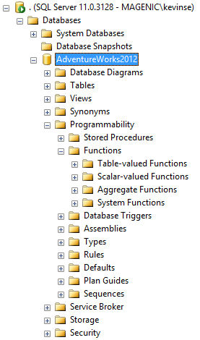
Data Definition Language
Allows you to create and modify SQL Server features:
Tables
Columns, Keys, Constraints, Indexes, etc.
Views
Stored Procedures
Triggers
Functions
Scalar and Table-Valued
Notes:
I won’t go into much detail on the implementation of these features, but if you’ve ever opened up SQL Server Management Studio and expanded nodes in the object browser (which I’m sure you have) then you’re probably already familiar with the existence of these items.
Difference between stored procedures, functions, views

Slide 4
Data Manipulation Language
SELECT
INSERT
UPDATE
DELETE

Slide 5
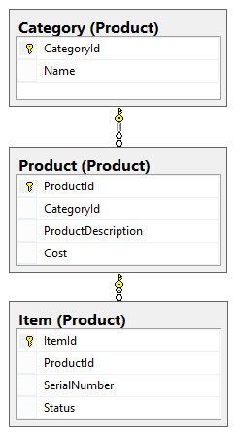
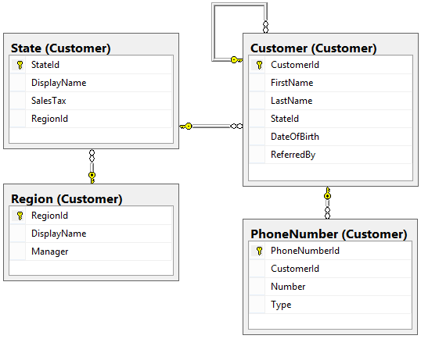
Sample DB

Slide 6
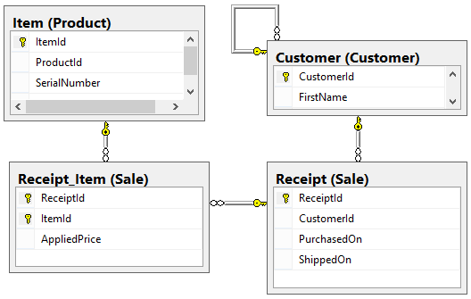
Sample DB

Slide 7
SELECT
[ WITH common_table_expr ]
SELECT …
[ INTO new_table ]
[ FROM table ]
[ WHERE predicate ]
[ GROUP BY expr pression ]
[ HAVING predicate ]
[ ORDER BY expr [ ASC | DESC ] ]
[ ALL | DISTINCT ]
[ TOP (expr) [ PERCENT ] [ WITH TIES] ]
column_list
column_name
alias = expression
expression AS alias
Notes:
SELECT: get rows from the database
Simplified version of the syntax as defined by MSDN

Slide 8
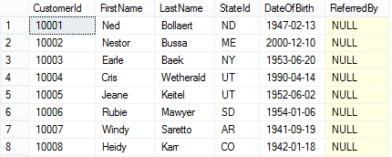
SELECT
SELECT * FROM Customer.Customer
Notes:
Here’s a simple example of a select statement.
I’m running with the assumption that you all have at least this level of comfort with SQL.
No sorting – well, it appears to be ordered by the CustomerId (the primary key) because it is a clustered index. It is stored that way for quick b-tree lookups on these values.
No filters.
Just pure data.

Slide 9
SELECT
Avoid SELECT * for performance and maintainability.
SELECT TOP (10) PERCENT [FirstName], [LastName], [DisplayName] = CONCAT([FirstName],‘ ‘, [LastName]) [DateOfBirth] FROM
[SQLPresentation].[Customer].[Customer] AS Cust
WHERE [StateId] = ‘MN’ AND [DateOfBirth] LIKE ‘198_%’
ORDER BY [LastName], [FirstName]
Parentheses are strongly encouraged for TOP; required elsewhere.
Watch out for implicit conversions and local/vs. UTC time.
Always qualify the name of your tables with schemas. Use database name as needed.
Alias your table names as needed, and do so consistently.
Notes:
A slightly more complicated example of a select statement, but still straightforward.
Instead of manually putting in search criteria, you might use parameters passed into a stored procedure.
I can’t speak for entity framework.
I want to discuss some small but important/interesting points about this query before we move on to more advanced queries and solve more interesting problems.
Avoid SELECT * in production for two reasons:
Performance.
If you have a lot of columns, that is a lot of unnecessary data.
If the data returned isn’t part of an index, you could be wasting server resources and affecting the query plan.
Maintainability. You might return data that someone else isn’t expecting. Future-proof.
Qualifying table names
Always qualify your table names by using the schema, even if you are just using the default schema.
Qualify with a database name if needed. Do this if you’re not sure if ‘use databaseName’ will be executed for your connection.
Alias your tables
Helpful if table names are a bit wordy.
Required if you use a self-join.
Your team can decide if you should use full words, abbreviations, one letter, etc. Just make sure it is understandable.
Once a table name is aliased, you must use that alias for the remainder of the query.
Qualifying column names
Qualify your column names using table names consistently.
Not always required.
Recommended if you join tables
Required if you join tables with conflicting column names (foreign keys)
Distinct
If the columns returned by this query for a row match some other row, the result is discarded.
Avoid using this to correct errors in your query if possible.
Top
“For backward compatibility, the parentheses are optional in SELECT statements. We recommend that you always use parentheses for TOP in SELECT statements for consistency with its required use in INSERT, UPDATE, MERGE, and DELETE statements in which the parentheses are required.”
Consistency is not guaranteed if you don’t order your results.
Avoid using TOP for paging – sending only chunks of data to the client.

Slide 10
SELECT Performance
Demo

Slide 11
SELECT NULL
What is NULL?
Examples
expr1 + expr2
WHEN expr = NULL
COUNT(*) vs. COUNT(expr)
CONCAT(‘str’, ‘str’)
ANSI_NULLS
Solutions
NULLIF
CASE
COALESCE
Notes:
NULL means “unknown.” In most cases, this means known value + unknown value = unknown value.
Two cases:
Storing data as null (e.g. customers don’t all have referrals)
Failing to join rows from different tables together based on a predicate
COUNT(*) counts ALL rows, even with null values. COUNT(expr) does not count nulls.
CONCAT replaces null values with empty string
NULLIF: Returns a null value if the two specified expressions are equal. (MSDN: NULLIF returns the first expression if the two expressions are not equal. If the expressions are equal, NULLIF returns a null value of the type of the first expression.)

Slide 12
SELECT Execution
Evaluation essentially happens all-at-once
Written order != execution order
Binding order
FROM
ON
JOIN
WHERE
GROUP BY
HAVING
SELECT ← expressions
DISTINCT
ORDER BY
TOP
Notes:
While discussing the SELECT syntax, I should point this out.
Unlike in C#, some value you set in your SELECT statement isn’t available for your use immediately. You must adhere to certain rules.
Because of this, more complex tasks may need to be broken up into multiple queries… but I like using a single query and avoiding any procedural loops – row by agonizing row.
We’ll discuss some solutions to problems caused by this and other SQL features in a bit. For now, the basics…

Slide 13
JOIN – What is it?
JOIN Product
Description
Model
Price ReceiptId/ItemId
FROM Item Serial
Status ProductId
JOIN Receipt_Item Discount ReceiptId/ItemId
Notes:
When data from one table isn’t enough, you join other rows from other tables onto this table/resultset.
Example: Item on its own is boring, so we add Product and Receipt_Item
Item is the first table in FROM – conceptually, your main table.
Branch out from your main table -- JOINs append additional information
Do we care about smaller result sets coming first?
Simple case: one-to-one
One-to-many and many-to-many might pose some difficulties as it results in redundant data.
E.G. looking up purchases for a customer AND putting their phone number in results, when phone numbers are stored in a different table.

Slide 14
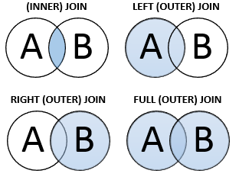

JOIN – Types
Notes:
4.5 main useful join types
INNER joins preserve both sides of the join. If rows do not match the join predicate, they are not included.
OUTER joins preserve one side of the join, meaning rows not matching the predicate are still returned in the results. In the event there is no matching row, nulls are used for the column values.
INNER and OUTER are implied when you are using JOIN and LEFT/RIGHT/FULL JOIN respectively. It’s up to you/your team if you want to include them, but pick a standard and stick with it.
I avoid RIGHT JOINs because they may make your query harder to understand. Swap join order.
CROSS JOIN is all records from one table, each paired with every record from another table.
SELF JOIN joins a table to itself. Represent a linked list or hierarchy – e.g. customer referrals or other one-to-one relationships of objects of the same type. Not an actual join keyword.
You will want to prefix each column in your select with the table names to prevent ambiguous column names from becoming a problem in the future if the database structure changes.

Slide 15
JOIN – Types
Demos

Slide 16
GROUP BY / HAVING
2
9
7
2
3
1
2
7
5
SELECT Color, AVG(Number), […]
FROM Colors
GROUP BY Color
Color: Green
Avg: 3
Count: 3
Max: 5
Color: Orange
Avg: 6.25
Count: 4
Max: 9
Color: Grey
Avg: 2
Count: 2
Max: 3
Notes:
The “group by” clause allows you to take rows, group them by one or more columns/expressions (e.g. group by year a purchase was made) and get aggregate information back for each group. Cannot get row-specific information out of the query unless it is a column used in the grouping.
We can get around limitations if we are creative...

Slide 17
GROUP BY / HAVING
Aggregate functions func ( [ ALL | DISTINCT ] expr)
AVG
COUNT(_BIG)
GROUPING
MAX
MIN
STDEV(P)
SUM
VAR(P)
Notes:
ALL is the default
DISTINCT only performs the operation once per each unique value
Without any group by or partitioning, aggregate functions operate on the whole result set as filtered by predicates.
GROUPING is for CUBE and ROLLUP
MIN/MAX do not need distinct but do support it for standards compliance
Standard deviation and statistical variance.

Slide 18
GROUP BY / HAVING
Demo
Notes:
These group by examples need some work.
Expressions get written multiple times throughout the query.
Can’t even display the customer’s name in the top customers list.
SQL isn’t good. We should just give up. Presentation’s over. Well, not quite…

Slide 19
SQL Problems Thus Far…
One-to-many or many-to-many joins – phone numbers example.
Not able to include non-aggregate information without adding excess GROUP BY definitions
Rewriting the same expression (math, etc.) multiple times
Notes:
If you remember my JOINs demo with phone numbers:
Potential for problems with some duplicated data. Sacrifice was to only show one phone number.
I don’t like the first two examples of group by I gave because:
they don’t allow me to get useful information like the customer name without adding unnecessary group by columns
I must repeat the same expression in the select, having, where, or group by – e.g. do some math in the select statement, then also try to filter results by the same equation
And more…
Solutions?

Slide 20

Your Toolbox
Subqueries
Common table expressions
Table variables
Temporary tables
T-SQL

Slide 21
Subqueries
Correlated vs. non-correlated
Top customers phone number demo
Notes:
“In Transact-SQL, there is usually no performance difference between a statement that includes a subquery and a semantically equivalent version that does not. However, in some cases where existence must be checked, a join yields better performance.”
“Many queries can be evaluated by executing the subquery once and substituting the resulting value or values into the WHERE clause of the outer query. In queries that include a correlated subquery (also known as a repeating subquery), the subquery depends on the outer query for its values. This means that the subquery is executed repeatedly, once for each row that might be selected by the outer query.”
WHERE clause depending on value from outside the subquery VS subquery which gets joined to with an ON clause, correlated vs. non-correlated respectively.
http://msdn.microsoft.com/en-us/library/ms187638(v=sql.105).aspx

Slide 22
Common Table Expressions (CTE)
Alternative to subquery
Temporary result set
Not stored as an object
Lifetime: single statement
Can reference multiple times within a statement
Recursion
Demo
Notes:
Great for our GROUP BY problem, among other things…
I only recently learned about these, they’re pretty awesome.
Doesn’t have performance benefit when compared to a non-correlated subquery… it’s more about writing easy to read statements
Use the resultset from one CTE in another CTE or as a join in your main query – building blocks!
Make sure the statement before your CTE has a semicolon
http://msdn.microsoft.com/en-us/library/ms190766(v=sql.105).aspx
“A common table expression (CTE) can be thought of as a temporary result set that is defined within the execution scope of a single SELECT, INSERT, UPDATE, DELETE, or CREATE VIEW statement. A CTE is similar to a derived table in that it is not stored as an object and lasts only for the duration of the query. Unlike a derived table, a CTE can be self-referencing and can be referenced multiple times in the same query.”
“Using a CTE offers the advantages of improved readability and ease in maintenance of complex queries. The query can be divided into separate, simple, logical building blocks. These simple blocks can then be used to build more complex, interim CTEs until the final result set is generated.”

Slide 23
Common Table Expressions (CTE)
INSERT INTO … SELECT
UPDATE … SET … FROM
DELETE FROM

Slide 24
CTE + PIVOT
HOME
MOBILE
WORK
Customer 1
5555551234
Customer 1
5554441233
Customer 1
5004443344
Customer 2
7633980000
Customer 2
6123334455
Customer 3
8005521299
Customer 4
8855445678
Customer 4
4476544379

Slide 25
CTE Alternative: Table Variables
On par with common table expressions
Useful for procedural work
Has the same lifetime as any other variable
Demo

Slide 26
CTE Alternative: Temporary Tables
Are written to disk; lengthy lifetime is a tradeoff for performance.
Used like any other table.
Denoted with a #.
You must delete them OR end your connection.
Demo.

Slide 27
Odds and Ends
SQL Operators, Functions, Data Types
INSERT, UPDATE, DELETE
Window functions
Pagination
SELECT ROW_NUMBER() OVER (ORDER BY PurchasedOn DESC) …
OFFSET 50 ROWS FETCH NEXT 50 ROWS ONLY
Compare to next/previous row(s), running totals, aggregates, etc.
Mock data generation demo

